Slide 1
Chapter 2, Part 2: An interpreter for an object-oriented language
Xinming (Simon) Ou
CIS 505: Programming Languages
Kansas State University
Fall 2010

Slide 2
A different memory organization
The C-like language interpreter uses a sequence of cells as the memory model
Matches closely to actual computer hardware
The object-oriented language interpreter will adopt a more “conceptual-level” memory model
A memory is a “heap” that collects objects
An object has a handle, and is represented as a namespace

Slide 3
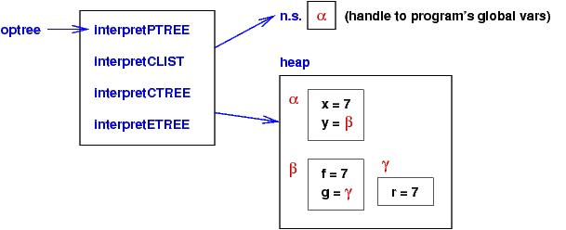
Example
x = 7;
y = new {f, g};
y.f = x;
y.g = new {r};
y.g.r = y.f;

Slide 4
Some key points
A handle is intuitively a memory location
In some sense an object variable is a “left value” by default, even if it appears on the rhs of an assignment.
Explicit de-reference is needed to access the “content” of an object
A big difference from C++, which requires explicit pointer declarations.

Slide 5
Syntax
P : Program
CL : CommandList
C : Command
E : Expression
F : FieldNames
L : LefthandSide
I : Variable
N : Numeral
P ::= CL
CL ::= C | C ; CL
C ::= L = E | if E : C1 else C2 end | print L |
E ::= N | ( E1 + E2 ) | L | new { F }
F ::= I | I , F
L ::= I | L . I
N ::= string of digits
I ::= strings of letters, not including keywords

Slide 6
Abstract Syntax
PTREE ::= CLIST
CLIST ::= [ CTREE+ ]
where CTREE+ means one or more CTREEs
CTREE ::= ["=", LTREE, ETREE] | ["if", ETREE, CLIST, CLIST] | ["print", LTREE]
ETREE ::= NUM | ["+", ETREE, ETREE] | ["deref", LTREE] | ["new", OB ]
OB ::= [ ID+ ]
where ID+ means one or more IDs
LTREE ::= [ ID+ ]
NUM ::= a nonempty string of digits
ID ::= a nonempty string of letters

Slide 7
Interpreter implementation
An object is a mapping from field names to field values, implemented as a dictionary
The heap is also a dictionary mapping handles (digit strings) to objects (dictionaries as well)
A memory address is called “left value”, or lval. It is a pair (handle, fieldname)
ns is just a handle for the object that maintains the mapping of all global variables

Slide 8
Some functions for managing the heap
allocateNS()
Create a new handle, and maps it to an “empty object”
dereference(lval)
Look up the heap for the object referred to by handle, and retrieve the value of a field
store(lval, rval)
Store the value rval in the location referred to by lval
(handle, fieldname)

Slide 9
Interpreter Cases
LTREE ::= [ ID+ ]
Return value?
Operation?
ETREE ::= …|["deref", LTREE]
Return value?
Operation?
ETREE ::= …|["new", OB ]
Return value?
Operation?

Slide 10
Interpreter Cases
CTREE ::= ["=", LTREE, ETREE]
| ["if", ETREE, CLIST, CLIST]
| ["print", LTREE]

Slide 11
Exercise
Show the interpreter result on the following program:
x = 2;
y = new {x, y};
y.x = x; y.y = y; x = y.x

