Slide 1
Blocks
D ::= var I = E | D1 ; D2
| class I = T | module I = D | import L
| begin D1 in D2 end
T ::= int | struct D end | array[E] of T | L
| begin D in T end

Slide 2
Using blocks to achieve the effect of private variables
class Entry = struct
var idnum = -1;
var balance = 0
end;
class DB(size) =
struct
begin var howmany = 0
var table = new array[size] of Entry
in
proc find(i){ ...table[i].balance()... }
proc update(i,...){ ...table[i] ... howmany ... }
end
end;

Slide 3
Subclasses and method override
Method override
A subclass can define a method with the same name and signature as a method in the superclass
When the method is called on an object of the subclass, the subclass’ method gets called
Method override is implemented as a form of dynamic scoping in object-oriented languages

Slide 4
Examples in Java
class Point {
int x; int y;
Point(int initx, int inity) {
x = initx; y = inity
}
void paint() {
System.paintPixel(x,y,255,255,255)
}
boolean equals(Point q) {
return x == q.x & y == q.y
}
}

Slide 5
class ColoredPoint extends Point {
int[] color;
ColoredPoint(initx, inity, initr, initg, initb) {
super(initx, inity);
color = new int[3];
color[0] = initr; color[1] = initg; color[2] = initb
}
void paint() {
System.paintPixel(super.x, super.y, color[0], color[1], color[2])
}
boolean equals(ColoredPoint q) {
return super.equals(q) &&
color[0] == q.color[0] &&
color[1] == q.color[1] &&
color[2] == q.color[2]
}
}
Method override
??

Slide 6
Point a = new Point(0,0);
ColoredPoint b = new Point(0,0, 255, 0, 100);
ColoredPoint c = new Point(0,0, 255, 0, 0);
a.paint();
b.paint();
a.equals(b);
b.equals(c);
b.equals(a)

Slide 7
Structure of ColoredPoint
{
int x;
int y;
void paint() { ... }
boolean equals(Point q) { ... }
int[] color = ...;
void paint() { ... }
boolean equals(ColoredPoint q) { ... }
}

Slide 8
Adding struct extension in the language syntax
T ::= int | struct D end | ... | T1 + T2
Example:
var p = new (struct
var x = new int;
var y = new int;
end
+
struct
color = new int[3]
end)
p.x = 0;
p.color[1] = 255

Slide 9
Subclass example in our syntax
class Point = struct
var x = new int;
var y = new int;
proc paint() { ...x...y... }
end;
class Color = struct
var color = new int[3];
proc paint() { ... super.x ... super.y ... color ... }
end;
class ColoredPoint = Point + Color;
var a = new Point;
var b = new ColoredPoint;

Slide 10
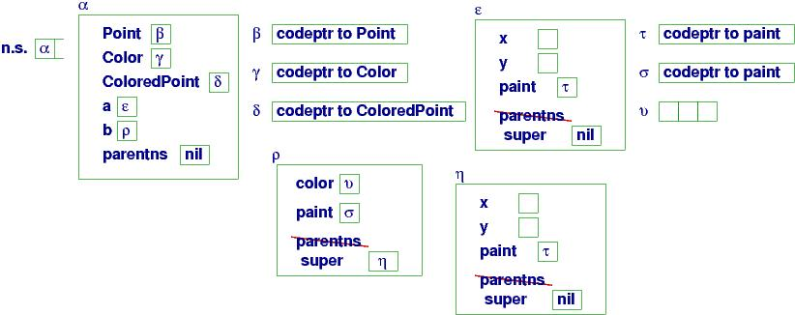
Storage layout

Slide 11
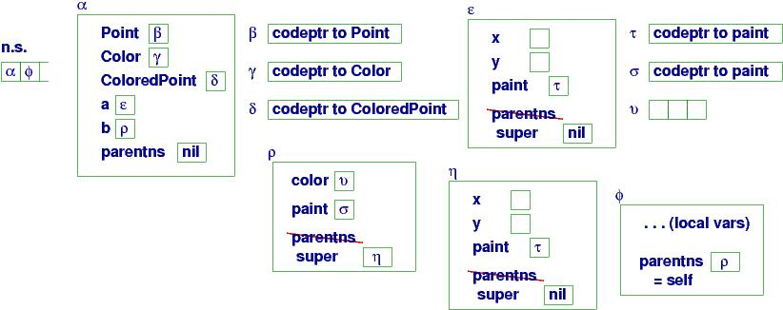
Calling b.paint()

Slide 12
A pathological example
class ColoredPoint extends Point {
int[] color;
ColoredPoint(initx, inity, initr, initg, initb) {
super(initx, inity);
color = new int[3];
color[0] = initr; color[1] = initg; color[2] = initb
}
boolean equals(Point q) {
if (q instanceof ColoredPoint)
{ return hasSameCoordinates(q) &&
color[0] == q.color[0] &&
color[1] == q.color[1] &&
color[2] == q.color[2]
}
else { return false }
}
}
class Point {
int x; int y;
Point(int initx, int inity) {
x = initx; y = inity
}
boolean equals(Point q) {
return x == q.x && y == q.y
}
boolean hasSameCoordinates(Point q) {
return equals(q)
}
}

