Slide 1
CIS 720
Homework and Midterm Review

Slide 3
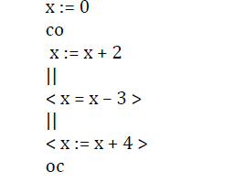

Slide 4
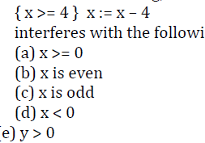

Slide 5
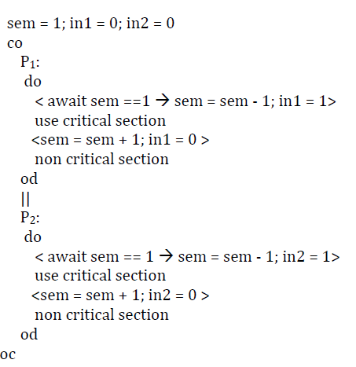

Slide 6
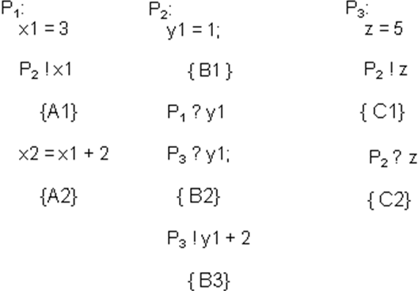

Slide 7
Left:
C ! left_request
cross the bridge
C ! left_leave
Right:
C ? right_request
cross the bridge
C ?right_leave
C :
left_in = 0; right_in = 0
do
? left_request→ left_in++
||
? left_leave → left_i --
||
! right_request → right_in++
||
! right_leave → right_i--
od

